Slide 1

Cardiovascular Disease Prediction
Group: 32
Presentation By:
Arnav Gupta
Karan Gupta
Shivesh Gulati
Vishal Singh
2021236
2021258
2021286
2021575

Slide 2


Outline
Introduction and Motivation
Literature Review
Dataset Description
Models and Methodologies
Result Analysis and Conclusion
Timeline
Contributions

Slide 3
Motivation
Introduction
The main goal behind this project is to detect the presence of cardiovascular disease, among people, using easy to determine parameters like Blood Pressure, cholesterol levels, glucose levels etc. using machine learning models.
Motivation
Cardiovascular diseases are one of the leading causes of fatalities worldwide. The primary motivation behind this study is to develop a machine learning model capable of predicting cardiovascular diseases(CVD) in an individual, using easy-to-determine parameters such as age, glucose levels, weight, and blood pressure indices. This can serve as a tool for early detection of the risk of cardiovascular diseases among individuals, allowing them to take preventive measures and seek medical attention at an early stage to reduce further risk.

Slide 4
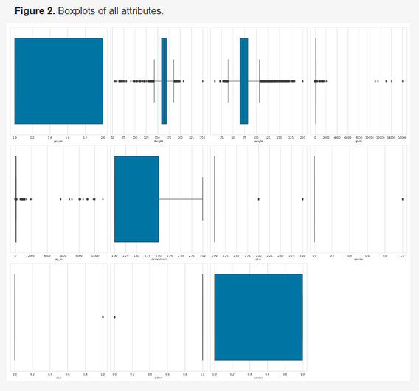

Literature Review
Research Paper-1
Aim: To develop a machine learning model to predict Cardiovascular
Disease Accurately
The dataset used, consisting of 70,000 records, was taken from Kaggle.com.
The study uses Decision trees, XGBoost, Random forest, and multilayer perceptron models. These were optimized using GridSearchCV.
Since dataset was mostly categorical, various techniques for outlier detection were used, resulting data had 57,155 instances.
Feature engineering such as binning(converting continuous data to categorical) was applied to age, height, weight, systolic blood pressure, and diastolic blood pressure.
Images taken from : https://www.mdpi.com/1999-4893/16/2/88

Slide 5
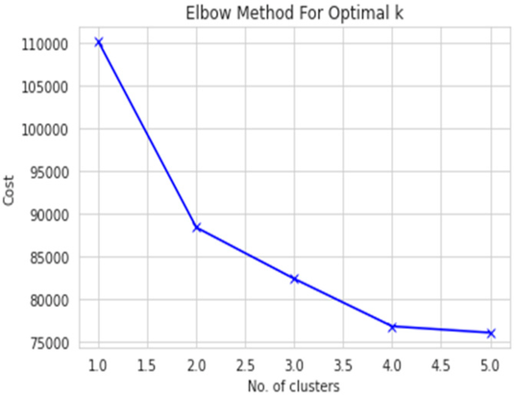
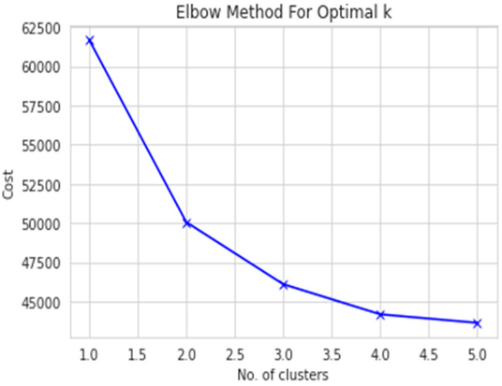
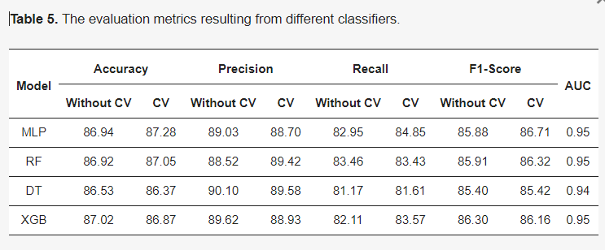
Literature Review
Research Paper-1(continued)
Aim: To develop a machine learning model to predict Cardiovascular
Disease Accurately
Two derived parameters, viz Body Mass Index (BMI) and Mean Arterial Pressure (MAP), were derived from age, weight, Systolic Blood Pressure, Diastolic Blood Pressure, respectively.
K-Modes clustering was used over K-means as it was not suitable for categorical dataset. optimal number was found using elbow curve method.
The dataset was divided on gender basis for better prediction.
The dataset was split into 80:20 for training and testing.
MLP was best to perform with an accuracy of 87.28% and other algorithms like XGBoost and random forest also showed comparable performances.
To conclude, this research paper applied models that achieved an accuracy of >86%, which could be further improved in the future to get more accurate predictions of CVD
Images taken from : https://www.mdpi.com/1999-4893/16/2/88

Slide 6
Literature Review
Research Paper-2
Aim: To understand the effectiveness of various BP indices in predicting Cardiovascular Diseases using Machine Learning Models.
The dataset used in this study, although not known in its entirety, was obtained from the ADVANCE study and consisted of the following attributes: age, sex, gender, SBP, MAP, DBP, PP, smoking, total cholesterol (HbA1c), and duration of mellitus (type-2 diabetes)
COX Proportional Hazard Regression Models were used to find the Hazard Ratio and the 95% confidence interval.
The ability of different BP indices, to discriminate among the participants was measured using AUC analysis.
For multivariate analysis, RIDI (Relative Integrated Discrimination Improvement) was used, which measured the increase in the discrimination obtained when new variables were introduced to the prediction model.

Slide 7
Literature Review
Research Paper-2
Conclusions: The overall conclusions obtained from the study were as follows:
It was observed during the study that for baseline BP estimates pulse Pressure (PP) and Mean Arterial Pressure (MAP) were more effective in CVD prediction.
In the case of achieved BP estimates, Systolic Blood Pressure (SBP) and Mean Arterial Pressure (MAP) performed better compared to other metrics.
Overall, if a combination of Blood Pressure variables is used, it was concluded that SBP and PP are superior to MAP and DBP in predicting CVD-related events.
DBP was observed to be the worst for predicting CVD-related events, mainly because of the fact that DBP tends to remain constant or even decrease after the age of 50-60 years

Slide 8












Shape Size and Derived Features
Dataset Source
Kaggle
Original Shape and Size
70,000 rows
13 columns
Target Variable
A binary variable “cardio“
(0 for no CVD, 1 for presence of CVD)
Summary of the dataset features
Dropped Column
Patient ID
Derived Features
Pulse Pressure (PP) = ap_hi-ap_lo
Mean Arterial Pressure (MAP) = ap_lo+1/3(PP)
Final Shape and SIze
70,000 rows and 14 columns (excluding Patient Id and adding PP and MAP)

Slide 9
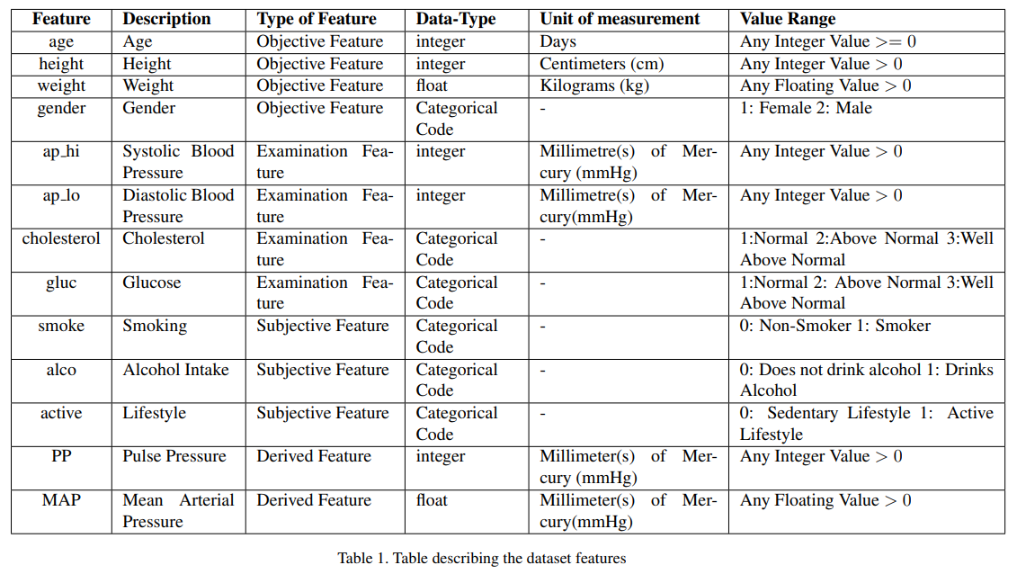
Feature Description

Slide 10
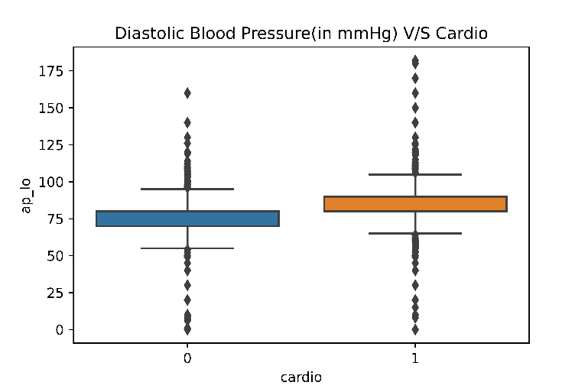
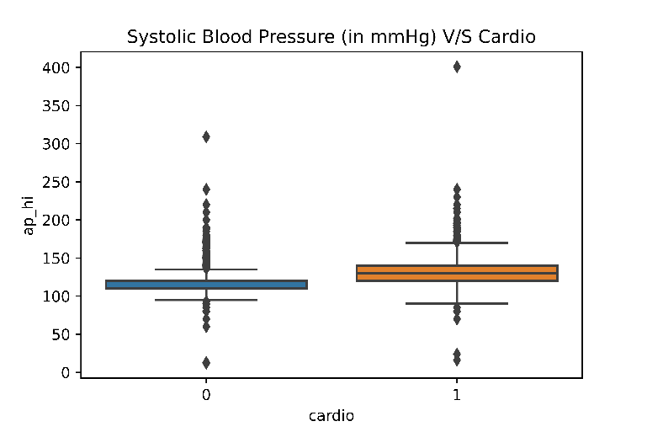
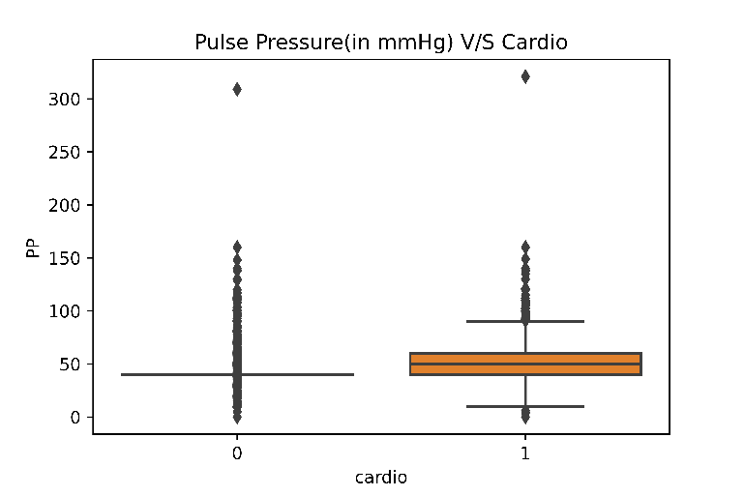
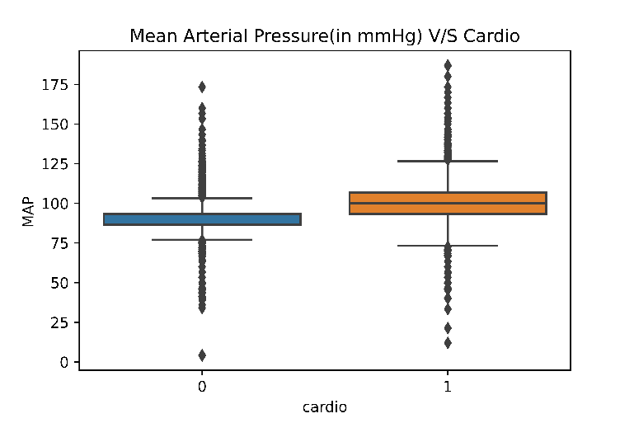
Box Plots
Inference
Inference
The number of outliers, in case of Diastolic Blood Pressure are high
The number of outliers, in case of Systolic Blood Pressure are higher than Dyastolic Blood pressure, but the quartiles are better defined.
Inference
Inference
The number of outliers, in case of pulse pressure are the highest.
Mean Arterial Pressure, shows the least number of outliers, and has significant size of the box.

Slide 11
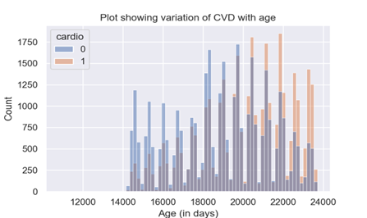
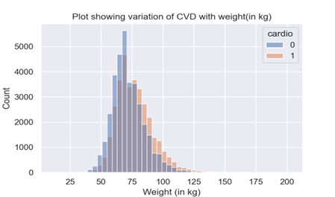
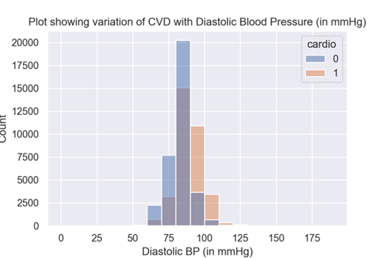
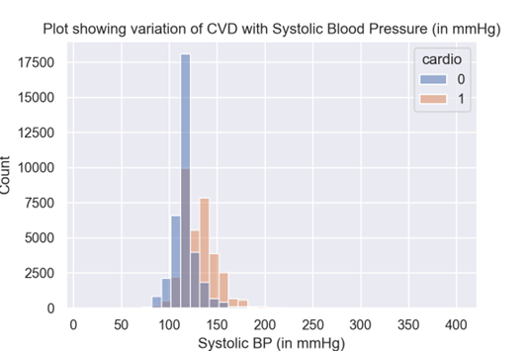
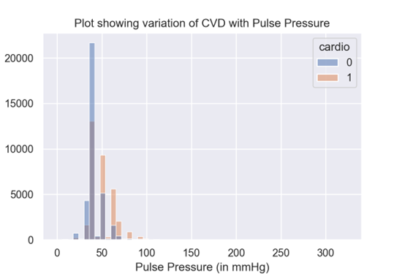
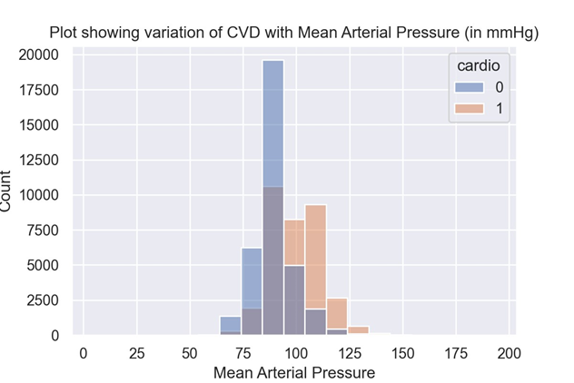
Histograms
Graph-1
Graph-2
Graph-3
Graph-4
Graph-5
Graph-6

Slide 12
Inferences from Histograms
Histograms were drawn to analyze the distribution of participants, with or without CVD, in specific ranges of the various numerical features. The insights obtained are as follows:-
As the age bracket increases, the number of people with CVD is higher than those without CVD, especially for people beyond 22500 days (61 years). (See Figure 1)
As the weight bracket increases, the proportion of people having CVD is significantly higher as compared to those not having CVD, especially in the 75 kg and beyond range (See Figure 2).
In populations with higher systolic, diastolic, and pulse pressures, cardiovascular disease (CVD) frequency is higher. Specifically, systolic BP >=140 mmHg, diastolic BP>=90 mmHg, and pulse pressure >=50 mmHg are associated with increased CVD prevalence. (See Figures 3,4,5,6).

Slide 13
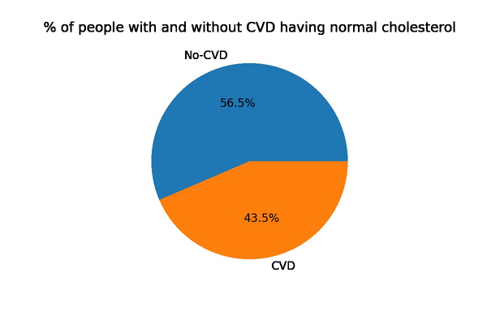
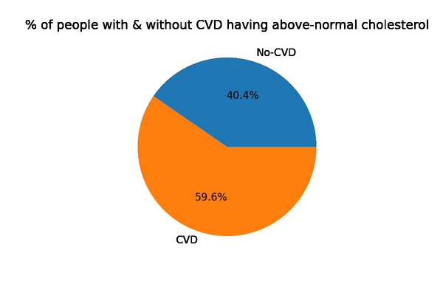
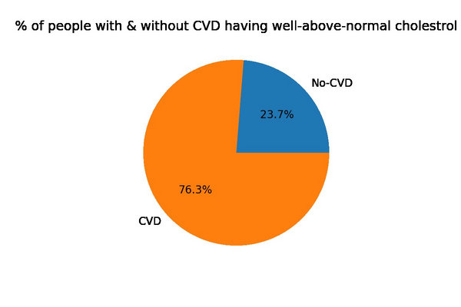
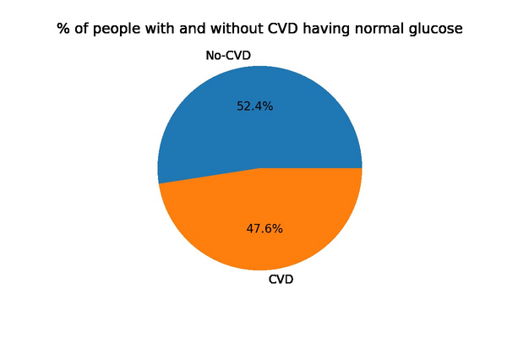
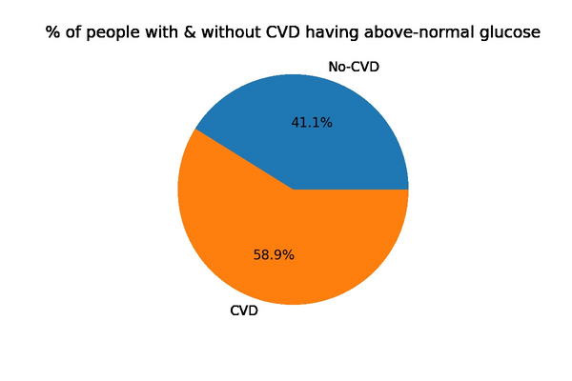
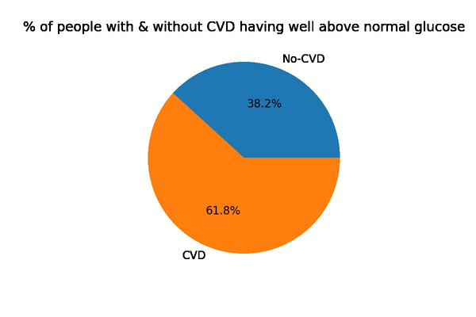
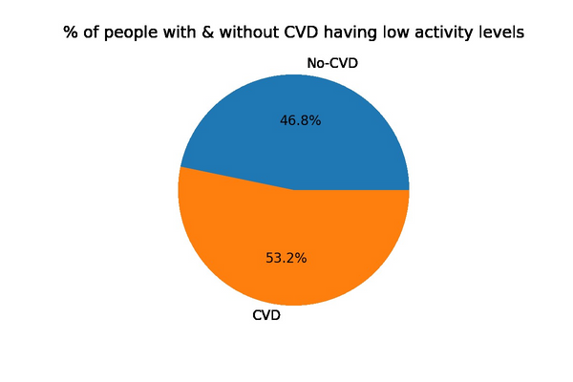
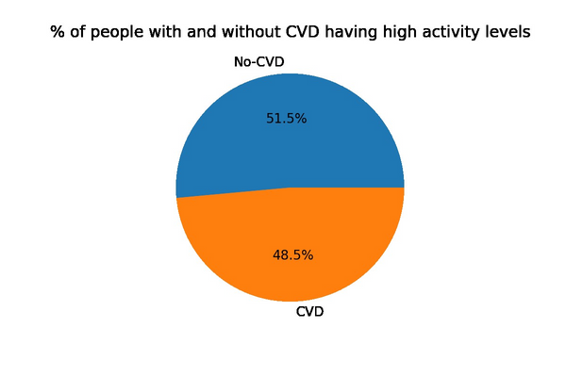
Pie Charts
Inferences
Pie charts were used to analyze the distribution of participants, with or without CVD, in various categories of categorical features :-
1) Proportion of people not having CVD in the normal cholesterol level category is higher as compared to the people having CVD in the above-normal and well-above normal cholesterol categories the proportion of people, having CVD, is higher, as compared to those not having CVD. A similar trend can be seen in glucose levels as well.
2) Out of the people with an active lifestyle, the proportion of people not having CVD is higher than those with CVD. Similarly, the people with a sedentary lifestyle have a higher proportion of people who have CVD than the ones not having CVD.

Slide 14
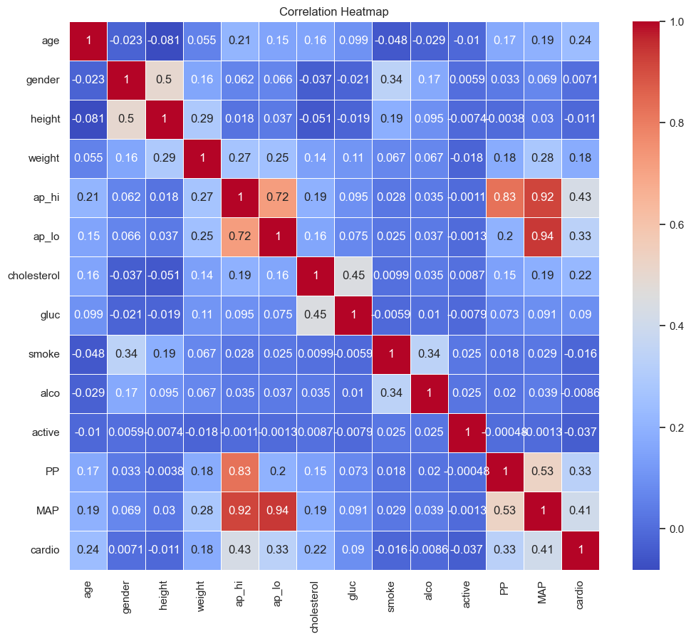
Correlation Heatmap
Ap_lo and Ap_hi have a strong correlation(close to 1) as greater diastolic pressure means a greater systolic pressure.
PP and MAP both have a strong correlation with ap_hi and ap_lo.
Ap_hi and map have a moderate correlation (around 0.5) with CVD as higher blood pressure generally means a greater risk of CVD.
PP ap_lo and cholesterol have somewhat moderate(around 0.3) correlation with CVD PP and MAP have a moderate correlation with each other

Slide 15




Flow Chart
XGBoost
Z-Score
Data Preprocessing
Model
Application
Naive Bayes
DTC
Logistic Regression
Random Forest
SVM
MLP
Data
Data input
Outlier
Detection
Naive Bayes
XGBoost
Logistic Regression
DTC
LOF
Data Preprocessing
Model
Application
SVM
Random Forest
MLP

Slide 16
Data Cleaning
Manual CAP
For the original and derived features of Blood Pressure, Values not in the range [0,500] were manually dropped.
Outlier Detection and Cleaning
Z-Score
70,000
68,727
Applied Z-Score on the Manually Capped Data
68,727
65,048
LOF
Applied Local Outlier Factor on the Manually Capped Data
68,727
54,981

Slide 17
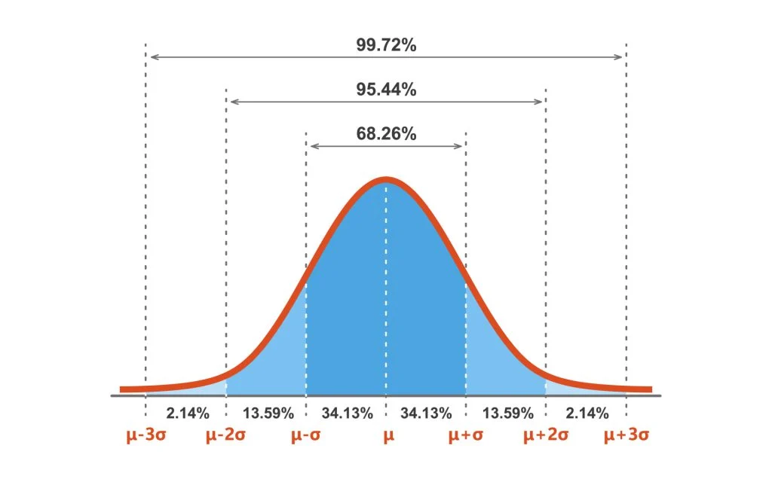
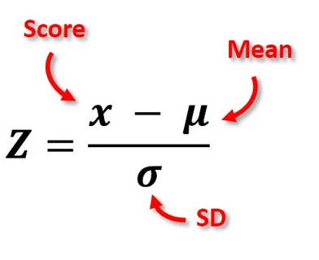
Z-Score
Formula
Lower bound=-2.75
Upper bound=2.75
Final size: 65,048
Image Source : https://www.simplypsychology.org/z-score.html

Slide 18
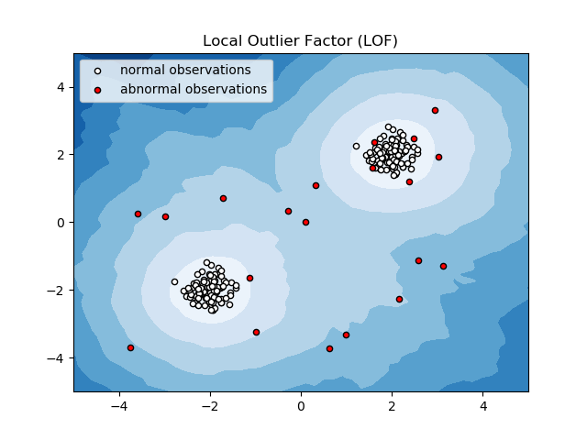
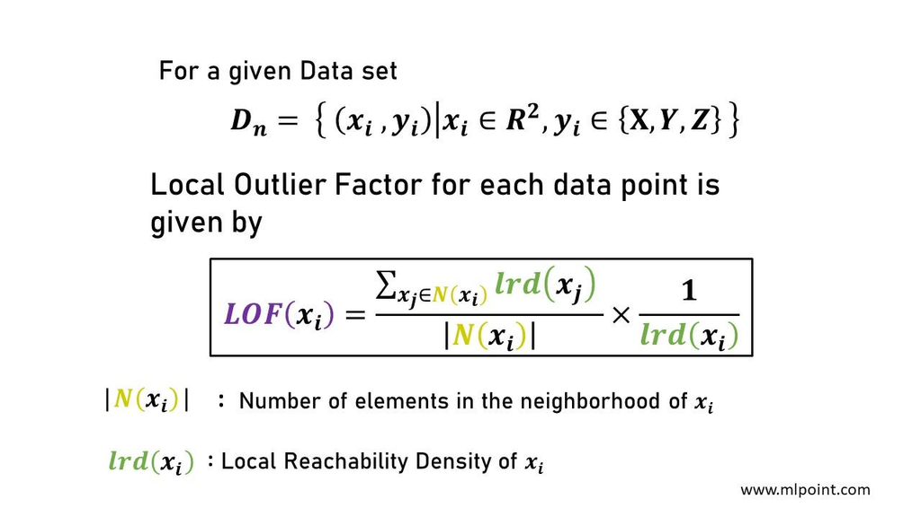
Local Outlier Factor
Formula
Final size: 54,981
Image Source: https://scikit-learn.org/0.19/auto_examples/neighbors/plot_lof.html

Slide 19
Data Pre-Processing
Train-Test-Split
70:30
Data Standardization
StandardScaler()
Image Source: https://stackoverflow.com/questions/39120942/difference-between-standardscaler-and-normalizer-in-sklearn-preprocessing

Slide 20

Flow Chart
XGBoost
Z-Score
Data Preprocessing
Model
Application
Naive Bayes
DTC
Logistic Regression
Random Forest
SVM
MLP
Data
Data input
Outlier
Detection
Naive Bayes
XGBoost
Logistic Regression
DTC
LOF
Data Preprocessing
Model
Application
SVM
Random Forest
MLP

Slide 21

Models and Methodologies
Classification Problem
Naive Bayes Classifier
Logistic Regression Classifier
Support Vector Machine
Multi Layer Perceptron
Random Forest
XGBoost
Decision Tree

Slide 22
Models and Methodologies
Standard Data
The Original Data had Label Based Encoded Features and Models were applied.
Data Processing
One Hot Encoding
The Original Label Based Features were converted to One Hot Encoding and the Models were applied.
One Hot Encoding + PCA
The One Hot Encoded data was used with PCA and the Models were applied. The optimal number of components for PCA, were determined using K-Fold Cross Validation
.

Slide 23
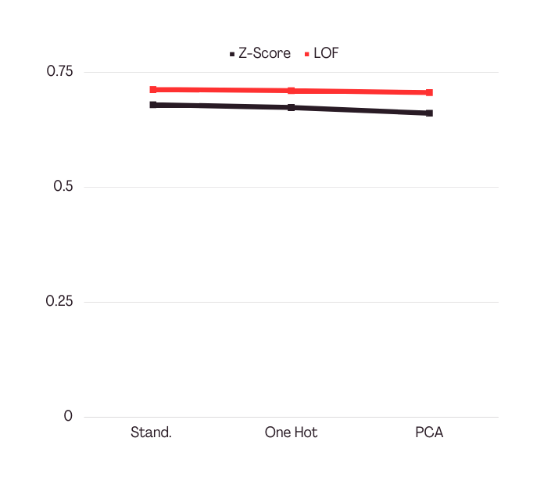
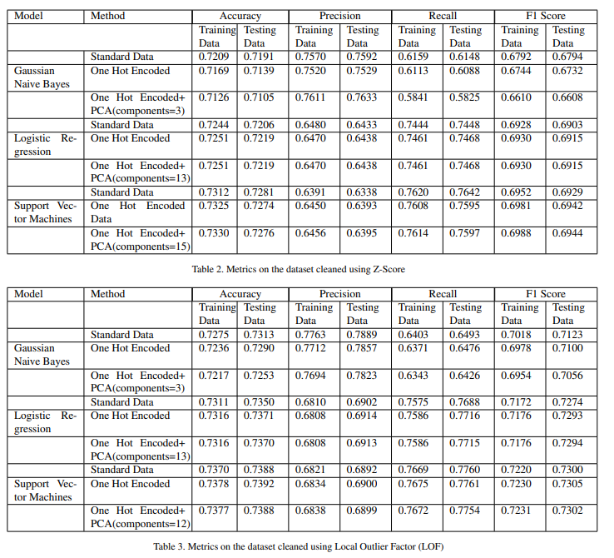
Models (Stats)
Naive Bayes
Z-Score Data
Standard Data
One Hot Encoded Data
One Hot + PCA Data
LOF Data
Standard Data
One Hot Encoded Data
One Hot + PCA Data
F1-Score

Slide 24
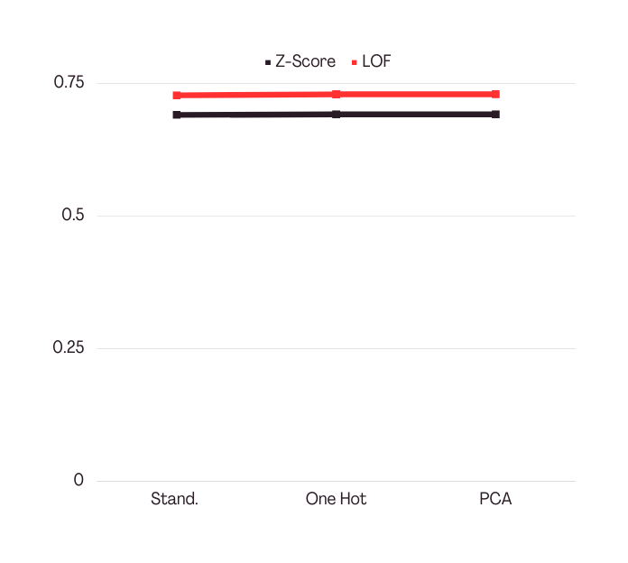
Models (Stats)
Logistic Regression
Z-Score Data
Standard Data
One Hot Encoded Data
One Hot + PCA Data
LOF Data
Standard Data
One Hot Encoded Data
One Hot + PCA Data
Model Parameters
F1-Score
Solver: newton-cg
Regularization Strength: 10

Slide 25
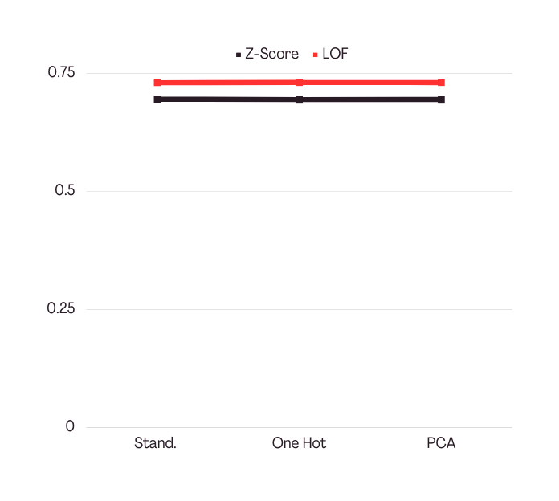
Models (Stats)
Support Vector Machine
Z-Score Data
Standard Data
One Hot Encoded Data
One Hot + PCA Data
LOF Data
Standard Data
One Hot Encoded Data
One Hot + PCA Data
Model Parameters
F1-Score
Regularisation Strength: 1
Kernel: rbf

Slide 26
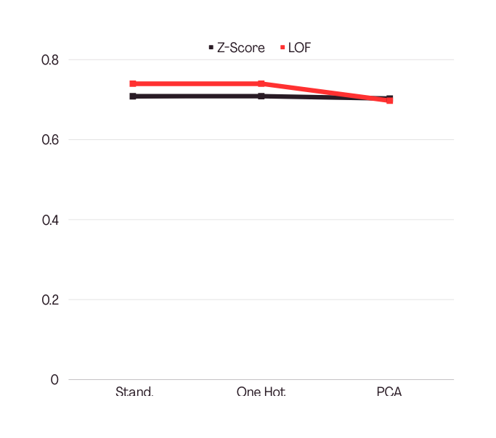
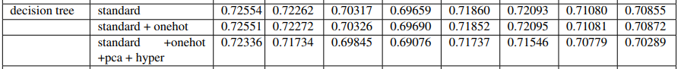
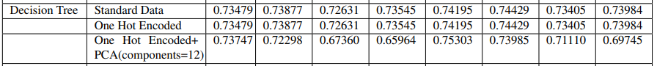
Models (Stats)
Decision Tree
Z-Score Data
Standard Data
One Hot Encoded Data
One Hot + PCA Data + GridSearchCV
LOF Data
Standard Data
One Hot Encoded Data
One Hot + PCA Data
Model Parameters
F1-Score
Max Depth: 7
Min Samples Split: 5
Min Samples Leaf: 1
Gini impurity

Slide 27
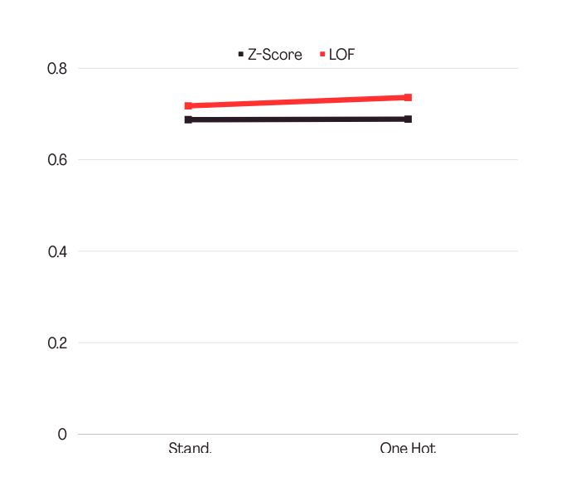
Models (Stats)
Random Forest
Z-Score Data
Standard Data
One Hot Encoded Data
LOF Data
Standard Data
One Hot Encoded Data
Model Parameters
F1-Score
max depth=15
max features=’log2’
min samples leaf=4
Gini impurity
n estimators=300
Bootstrap=True

Slide 28
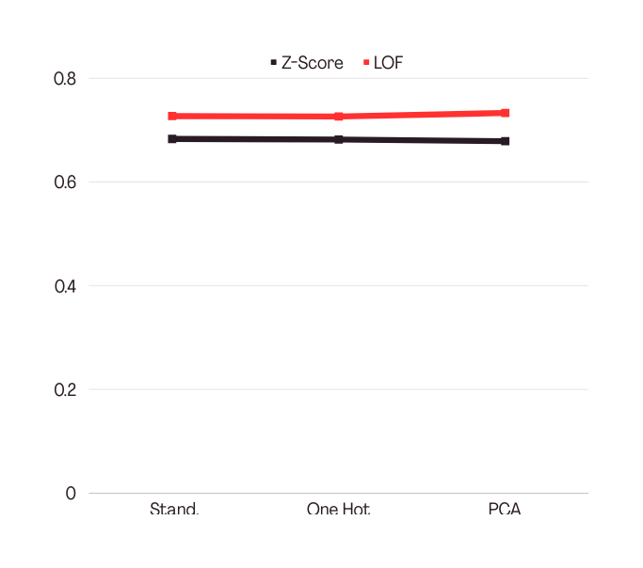
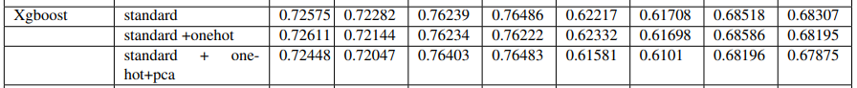
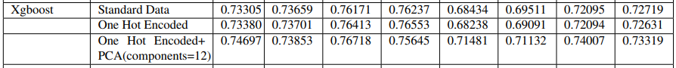
Models (Stats)
XGBoost
Z-Score Data
Standard Data
One Hot Encoded Data
One Hot + PCA Data
LOF Data
Standard Data
One Hot Encoded Data
One Hot + PCA Data
Model Parameters
F1-Score
learning rate: 0.2
max depth: 3
n estimators: 100

Slide 29
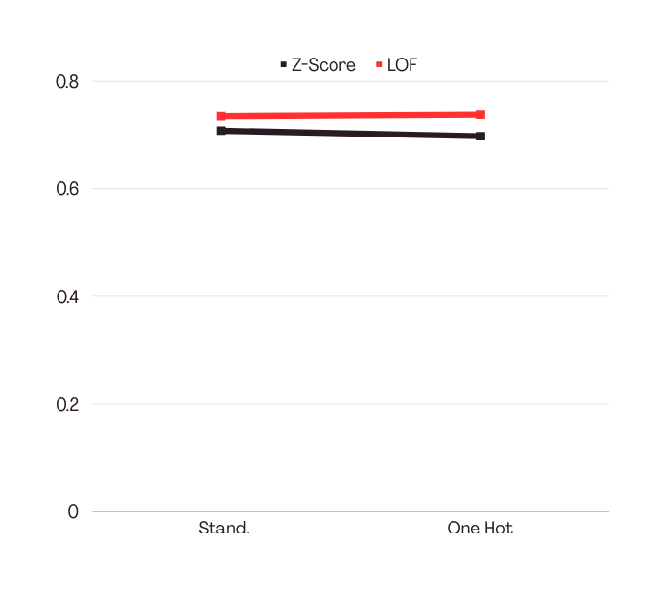
Models (Stats)
Multi Layer Perceptron
Z-Score Data
Standard Data
One Hot Encoded Data + GridSearchCV
LOF Data
Standard Data
One Hot Encoded Data
Model Parameters
F1-Score
Neurons in hidden layer-1 : 300
Neurons in hidden layer-2: 250

Slide 30
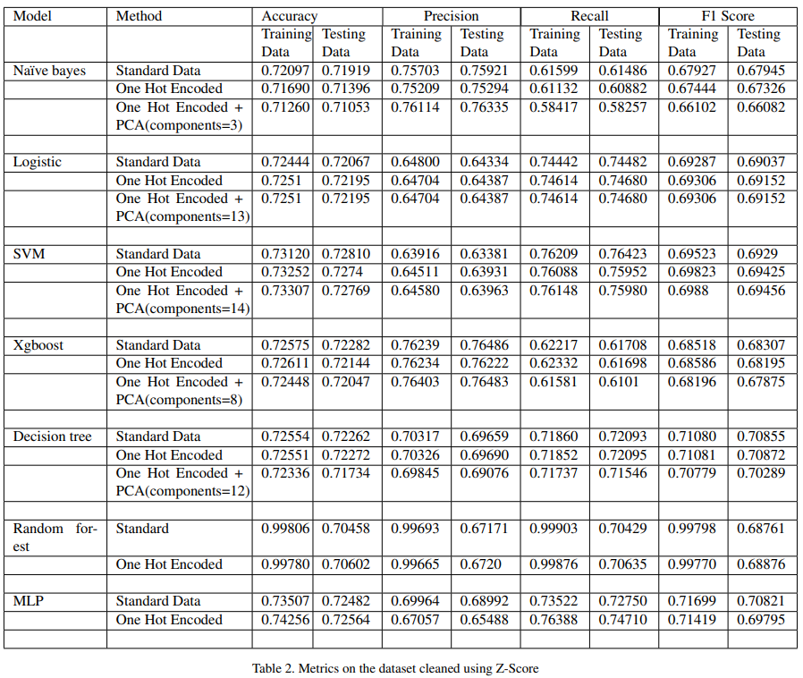
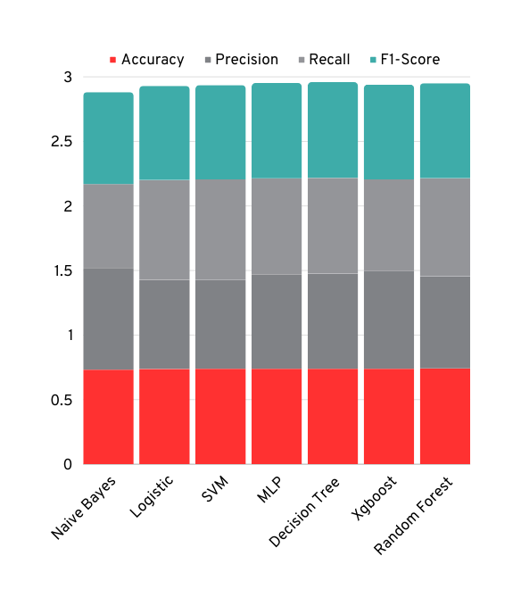
Stats - Z-Score

Slide 31
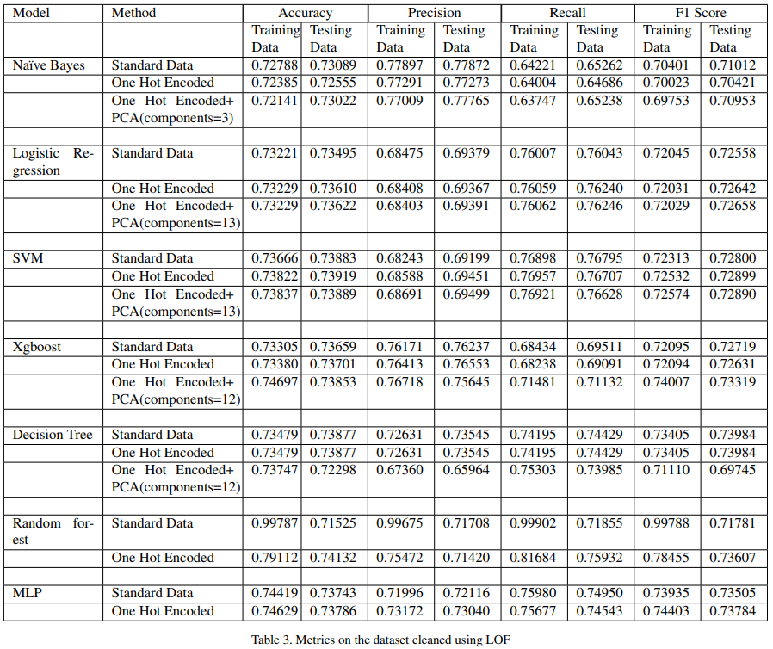

Stats - LOF

Slide 32
Analysis
Using F1 Score or Accuracy as evaluation metric: Tradeoff between Precision and Recall.
False Negatives are more harmful than false positives in our case. Thus, a higher recall is preferred.
Best Recall was observed in the case of the Support Vector Machine (0.76921), obtained after applying PCA on one hot encoded data cleaned using LOF after tuning the hyperparameters.
It can be observed that the F1 scores of all the models trained on the data with LOF as a method of outlier removal were higher than the models trained on data with Z-Score as the outlier removal method.
PCA was not applied to MLP since it is capable of handling complex relationships between the features and the data points. Applying PCA preserves the global structure, whereas the local structure is distorted. However, the initial layers of the MLP are capable of recognizing the local structure within the data; hence, distorting it might render these initial layers useless, resulting in lower performance metrics.

Slide 33
Conclusions
From the above analysis, it can be concluded that out of all the models applied, the best performance (considering the F1 score as the overall evaluation metric) was achieved by the Decision Tree (0.73984) followed by Multi-Layer Perceptron (0.73784).
If we observe the accuracies of the model, we can observe that the best accuracy was observed in the case of Random Forest with an accuracy of 0.74132, which was closely followed by Multi-Layer Perceptron 0.73919.

Slide 34
Our Learnings
Solving some complex machine learning problems using classical machine learning models.
Learning how to perform Exploratory Data Analysis, in order to gain valuable insights into the dataset.
Learning how to set parameters for the model while balancing the tradeoff between computational complexity and performance.
Applying different regularization techniques, while ensuring a proper balance between bias and variance.

Slide 35
Timeline
1-2
3
4
5
Data Cleaning
Pre-Processing
Research Paper Review
Outlier Detection
Data Visualization
Feature Extraction
Analysis of Features (Selection, correlation, etc.)
8
7
6
Decision Trees and Random Forest
Report
Presentation
Logistic Regression Naive Bayes
SVM
9
10
11
12
Xgboost
Multi-Layer Perceptron
Hyperparameter Tuning
Final Report Writing
Final Presentation

Slide 36
Contributions
Arnav Gupta
Karan Gupta
Shivesh Gulati
Vishal Singh
2021236
2021258
2021286
2021575
Contributions:
Data Cleaning
Multivariate Exploratory Data Analysis
Outlier Detection using Z-Score
Support Vector Machines
Decision Tree Classifier
Slides
Contributions:
Data Cleaning
Multivariate Exploratory Data Analysis
Naive Bayes
Random Forest
Report Writing
Slides.
Contributions:
Literature Review (RP-2)
Univariate Exploratory Data Analysis
Logistic Regression
Multi Layer Perceptron
Report Writing
Slides.
Contributions:
Literature Review (RP-1)
Outlier Detection using Local Outlier Factor
Data Preprocessing
Support Vector Machines
XGBoost
Slides.

